Slide 1
Last Chance Range
Desert Bighorn Sheep Herd

Slide 2
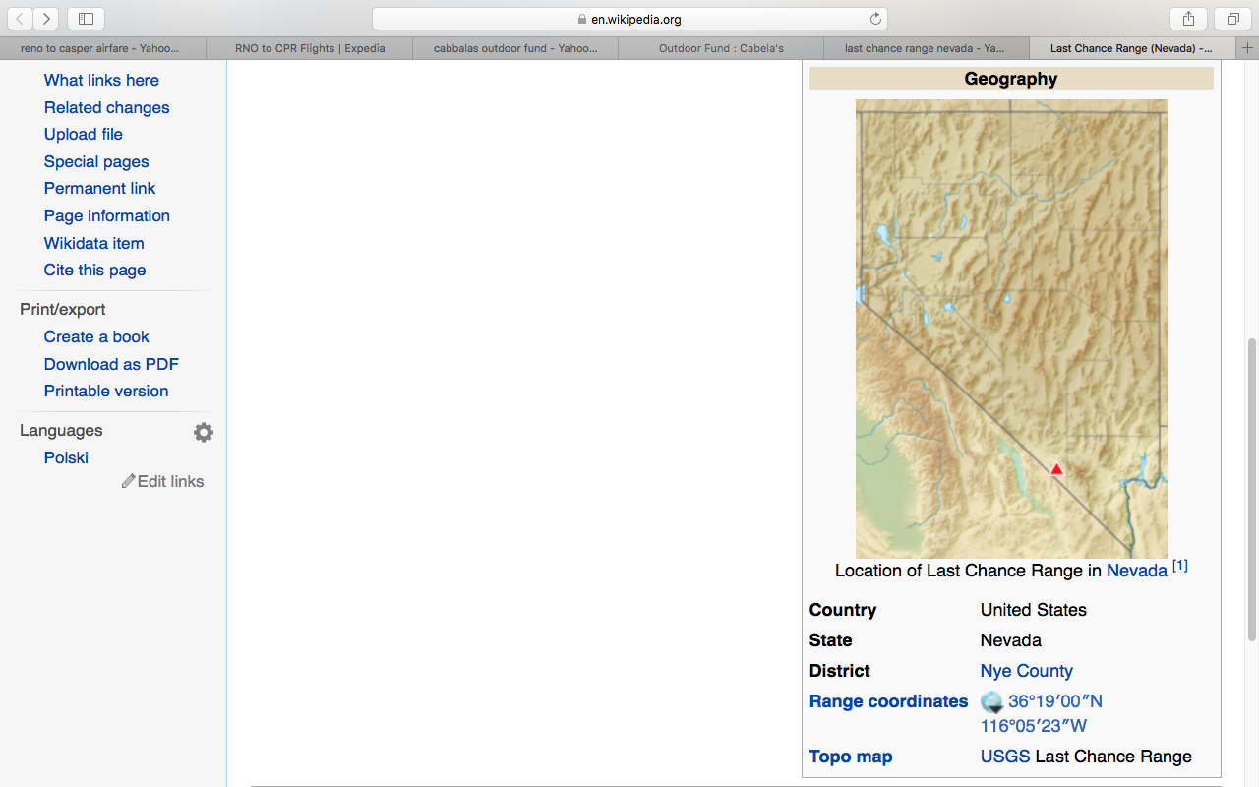
Location: West of Las Vegas, Nevada

Slide 3
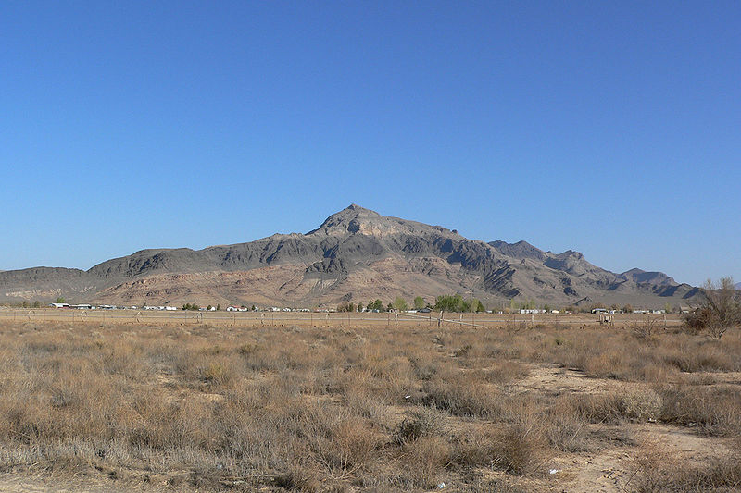
The range, as seen from Pahrump to the south

Slide 4
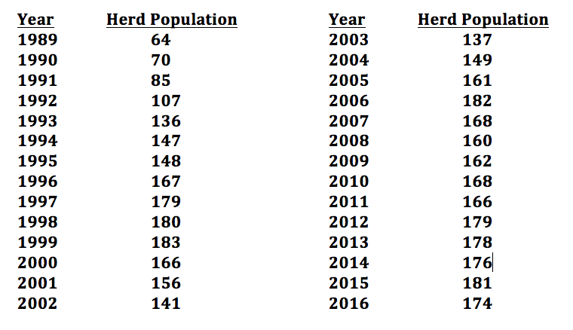
Population Data of the Herd

